Slide 1
RTO GOVERNANCE SYSTEM
For
VISHWA MOTOR DRIVING SCHOOL
By
Shrikant Suryawanshi(47)
Class : SYMCA
Div: B
Guide: Pranita Manjre

Slide 2
Company Profile
Vishwa Motor Driving School is a company, which provides training for driving, and offers private driving instruction that prepares students and skill levels for driving tests and fulfills defensive drive requirements.
Licence.No: MH122022DSL00049
Address:
Dhayari Sighgad Road, Dhayri Fata,
Pune-411041
Vishwa Motor Driving School provides following facilities
Learning license
License Renewal
Address Change
Vehicle Transfer
Vehicle Insurance
Vehicle Passing

Slide 3
INTRODUCTION
It is to provide an online tool for the ease of RTO functions such as vehicle registration, Learner license, permanent license, renewal of license, and many more.
This web application helps for RTO office employees as well as citizens of India. It will reduce considerably the difficulties faced on existing system, with minimum error and difficulties.
The RTO employees having lot of work burden of making registration, License issue, transfer, etc., which required lot of paper work.
“RTO Governance System” has been designed to automate the process of registration of vehicle and issuing driving license process.
System can make the daily activities efficient and providing the fast response to store and retrieve information.

Slide 4
OBJECTIVES:
The objective of this project is RTO provides the facility of applying licenses In this system admin can approve learning license number and also pass the vehicle registration number which will save users time.
This system ensures data integrity and data security
This system resolves all the issues like International Driving Permit , PSV Badge to Drive and Issue Of NOC etc.
Through RC book it gives information whether your vehicle is registered with any Regional Transport Office within the country this help us to maintain data easily

Slide 5
EXISTING SYSTEM
Existing RTO Office work is very complex, waste of time & much more Real-life problem for example if a person wants to make driving license then he or she first goes to RTO office and then they give work to the agent and then agent complete their work by taking a lot of money.
In this way when passing his or her vehicle number, insurance of that vehicle, etc. are taking a lot of time. And nowadays each and every person is in hurry so by analyzing and considering these problems we are developing one web application which overcomes this problem and get a solution in an efficient way.

Slide 6
SCOPE OF Work
This project works online which helps RTO office employees and Indian citizens. The System keeps track of the transactions in the RTO office.
It maintains Renewal of Online LLR Form, Registration Form, Issue of permanent license, learner’s License, Renewal of permanent license, Issue of learner’s license, payment against challan and finally it produces printouts to payment of customers.

Slide 7
Operating Environment: Hardware and Software
Hardware Specification
Component Name Specification
Processor : Intel(R) Core(TM)i3-7020U CPU @2.30GHzprocessor
RAM : 200MB of 4.00 GB RAM
Hard Disk : 20 GB maximum Hard Disk space
Keyboard : 122 keys

Slide 8
Operating Environment: Hardware and Software
Software Specification
Component Name Specification
IDE : Notepad
Database : MySQL
Operating System : Windows 10
Documentation Tool : Microsoft office
Browser : Google Chrome

Slide 9
Technology Used
Front End: HTML5, CSS3, Bootstrap
Back End: PHP, MYSQL
PHP:
PHP is a server side scripting language that is embedded in HTML. It is used to manage dynamic content, databases, session tracking, even build entire e-commerce sites.
It is integrated with a number of popular databases, including MySQL, PostgreSQL, Oracle, Sybase, Informix, and Microsoft SQL Server.

Slide 10
Technology Used
XAMPP:
XAMPP is one of the widely used cross-platform web servers, which helps developers to create and test their programs on a local webserver. It was developed by the Apache Friends, and its native source code can be revised or modified by the audience.
XAMPP is an abbreviation where X stands for Cross-Platform, A stands for Apache, M stands for MYSQL, and the Ps stand for PHP and Perl, respectively.

Slide 11
Technology Used
Operating systems used (Windows or Unix)
Windows:
Windows is a graphical operating system developed by Microsoft. It allows users to view and store files, run the software, play games, watch videos, and provides a way to connect to the internet. It was released for both home computing and professional works.

Slide 12
Technology Used
Database (mysql/ oracle, Teradata, etc.)
MySQL:
MySQL is the world’s most popular open source database.
MySQL is a relational database management system based on the Structured Query Language, which is the popular language for accessing and managing the records in the database.

Slide 13
Proposed System
The proposed system is aimed to automated the major processes in the regional transport office.
Online RTO governance system for different License and Vehicle Registration requirement.
Providing online exam to user based on their sufficient time requirement can save the time.
By giving proper information needed for passing their number we will provide number template to user so that it is not time consuming process.
The administrator is providing for authentication purpose as well as it handles all the database of RTO and manages all the process.

Slide 14
Objectives of proposed system
The proposed system is aimed to automated the major processes in the regional transport office.
Online RTO governance system for different License and Vehicle Registration requirement.
Providing online exam to user based on their sufficient time requirement can save the time.
By giving proper information needed for passing their number we will provide number template to user so that it is not time consuming process.
The administrator is providing for authentication purpose as well as it handles all the database of RTO and manages all the process.

Slide 15
DIAGRAMS

Slide 16
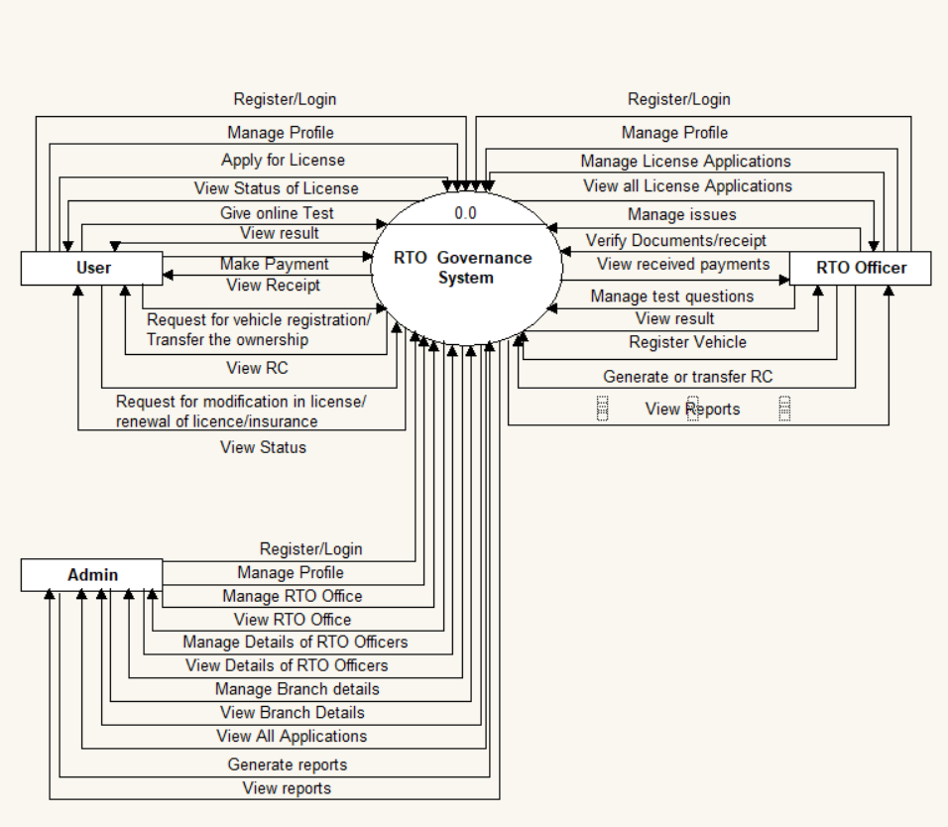
CONTEXT LEVEL-DFD

Slide 17
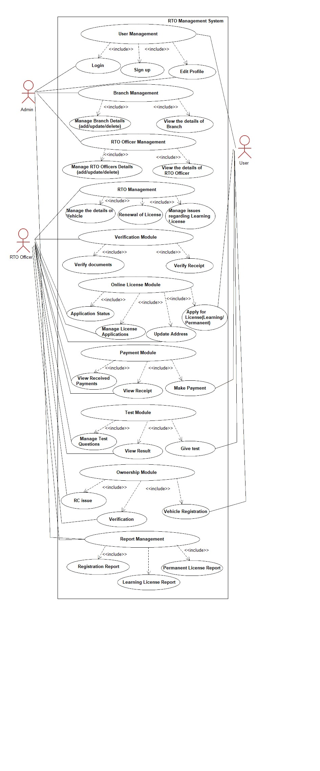
Use Case Diagram

Slide 18
CLASS DIAGRAM

Slide 19
Activity Diagram

Slide 20
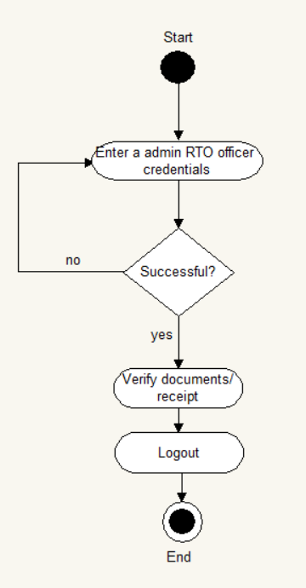
Verification Module

Slide 21
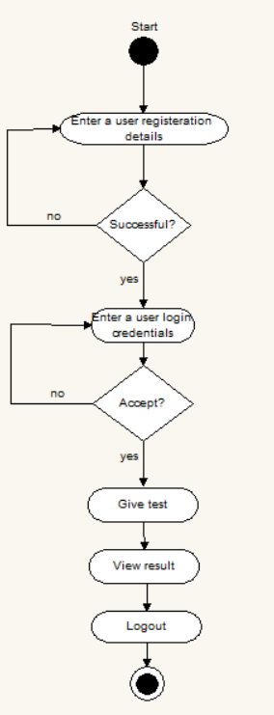
Test module- user side

Slide 22
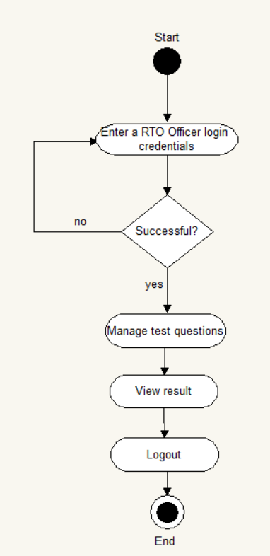
Test module- RTO officer side

Slide 23
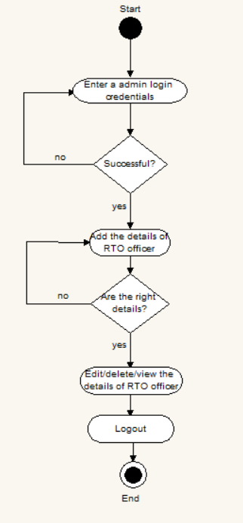
RTO officer management

Slide 24
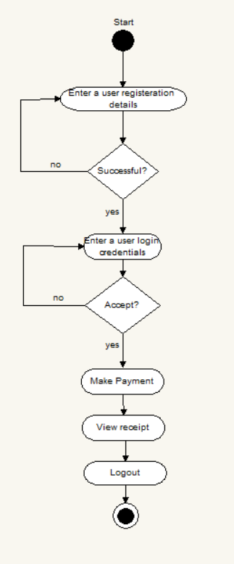
Payment module- user side

Slide 25
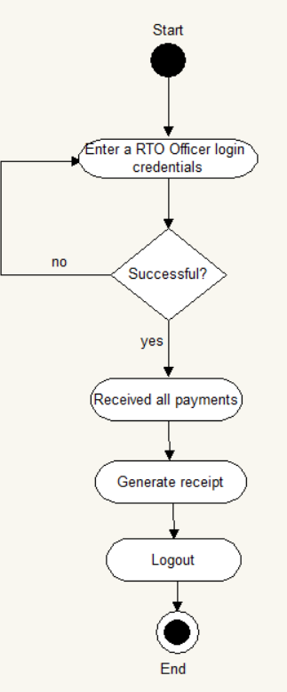
Payment module- RTO officer side

Slide 26
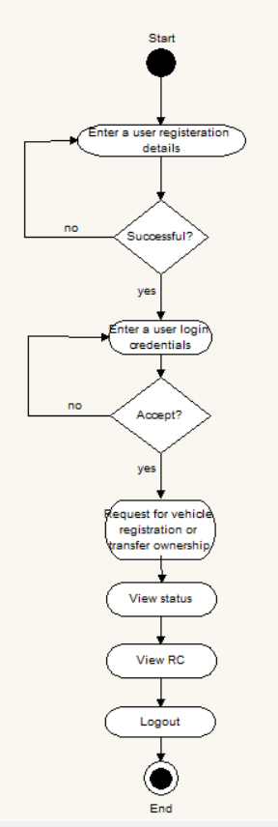
Ownership module-user side

Slide 27
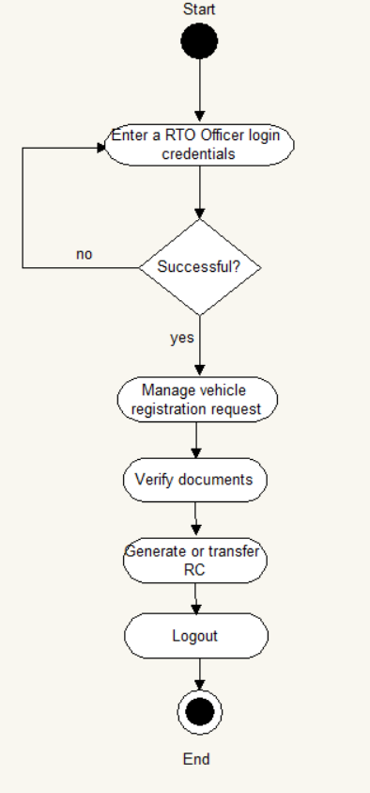
Ownership module- RTO officer side

Slide 28
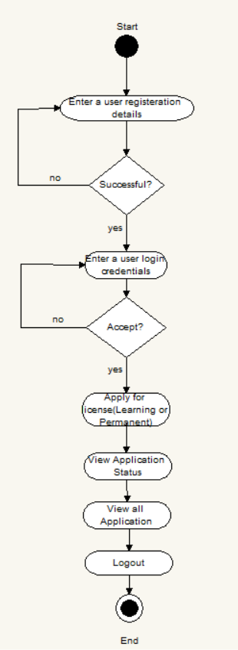
Online License Module-user side

Slide 29
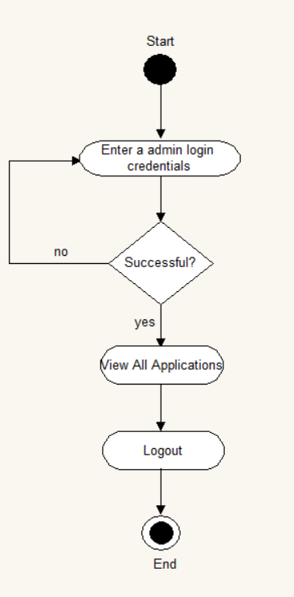
Online License Module-admin side

Slide 30
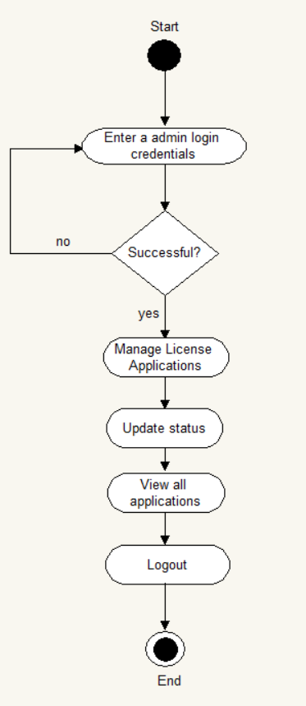
Online License Module - RTO officer side

Slide 31
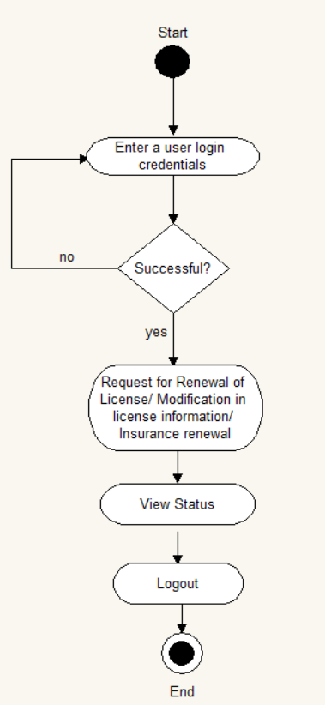
Issue module - user side

Slide 32
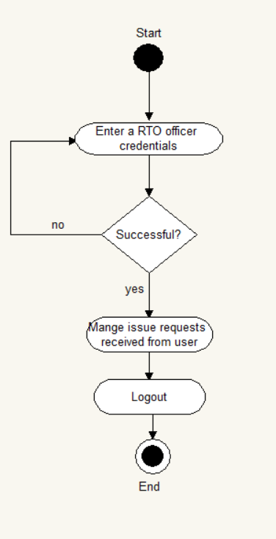
Issue module - RTO officer side

Slide 33
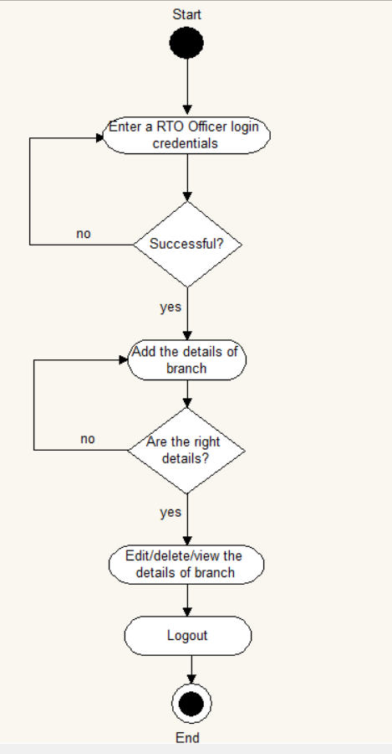
Branch management

Slide 34
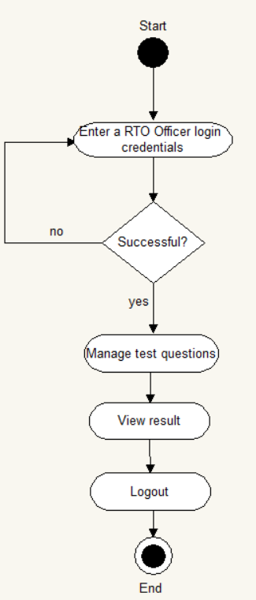
Test Module

Slide 35
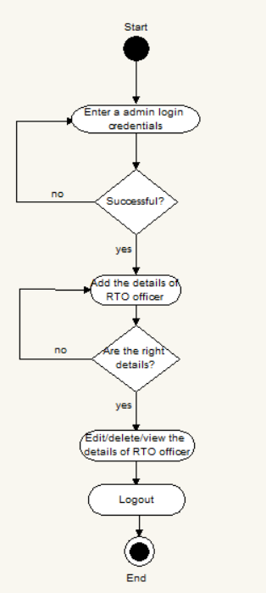
RTO officer management

Slide 36
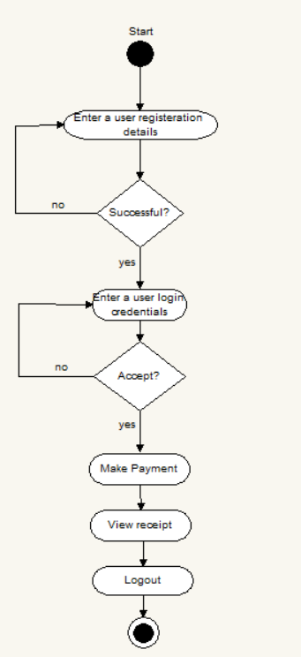
Payment module- user side

Slide 37
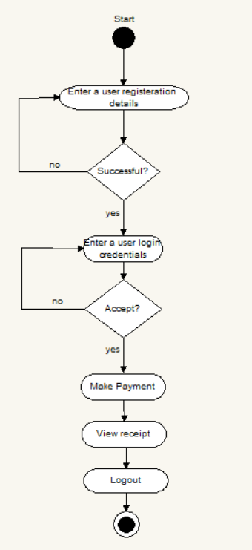
Payment module- RTO officer side

Slide 38
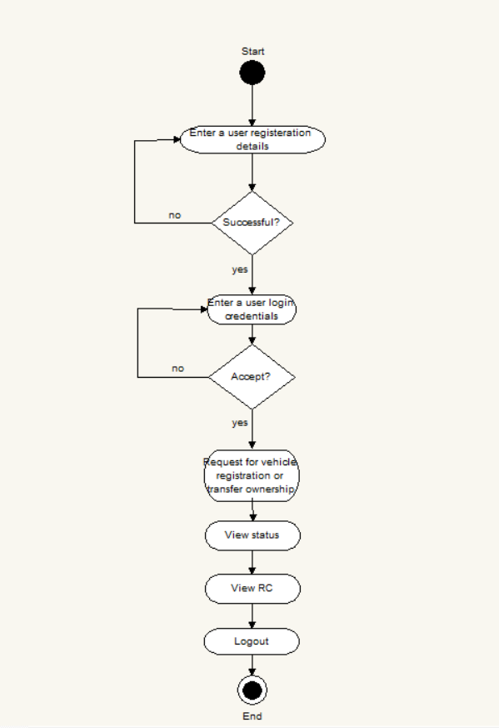
Ownership module-user side

Slide 39
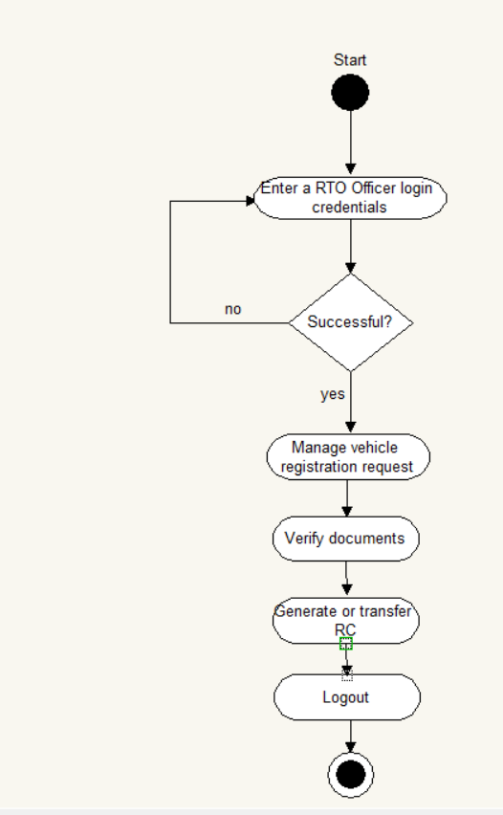
Ownership module- RTO officer side

Slide 40
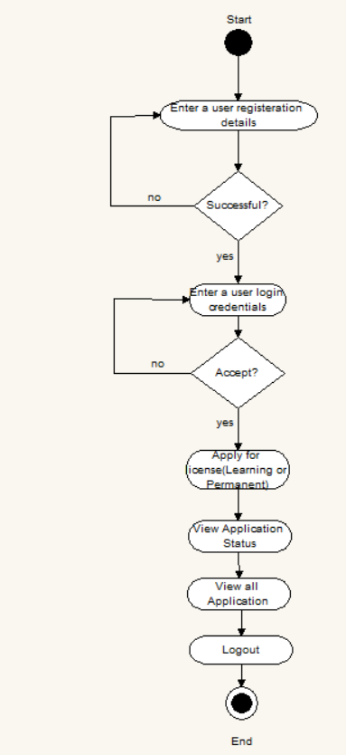
Online License Module-user side

Slide 41
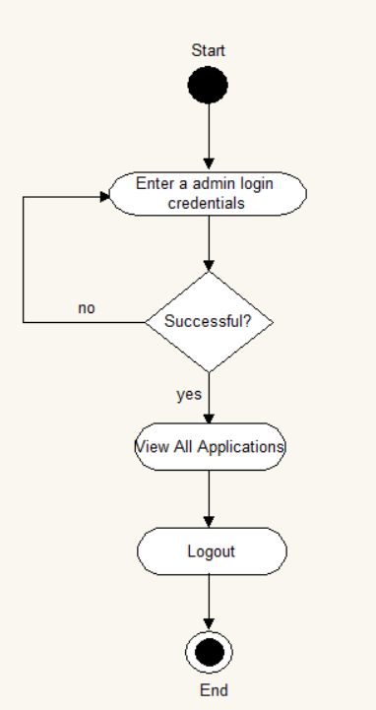
Online License Module-admin side

Slide 42
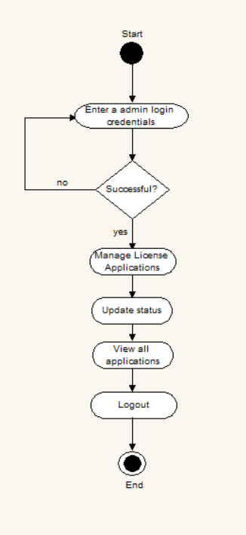
Online License Module - RTO officer side

Slide 43
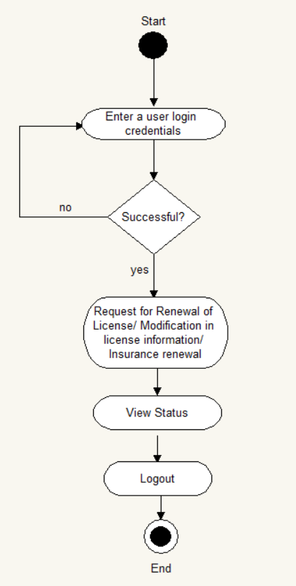
Issue module - user side

Slide 44
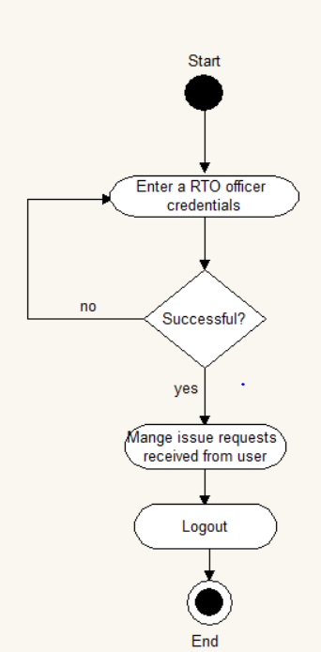
Issue module - RTO officer side

Slide 45
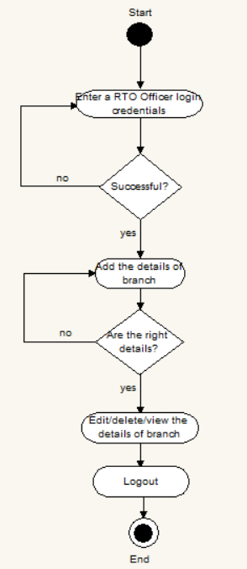
Branch management

Slide 46
Sequence Diagram

Slide 47
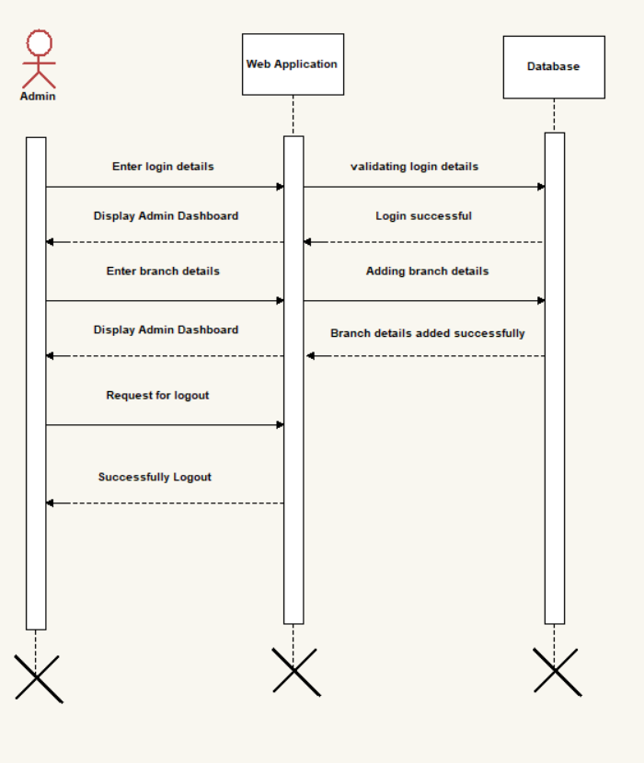
branch management

Slide 48
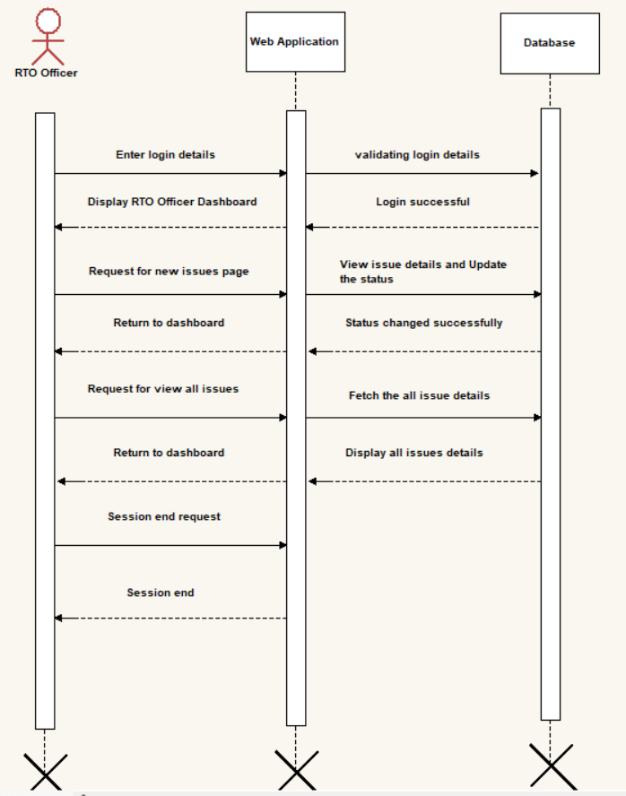
Issue module RTO Officer side

Slide 49
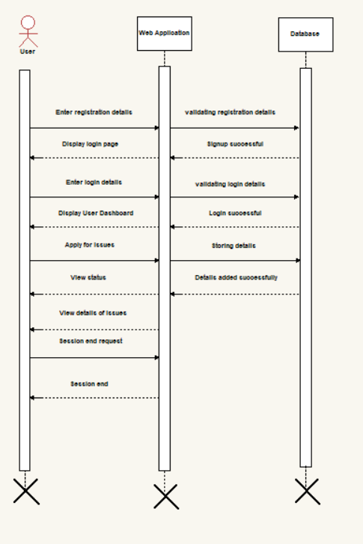
Issue module user side

Slide 50
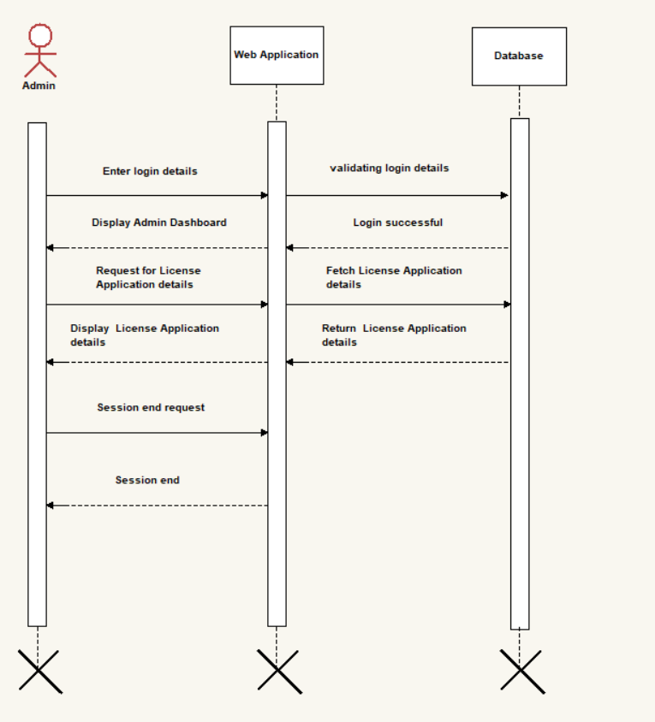
Online License module admin side

Slide 51
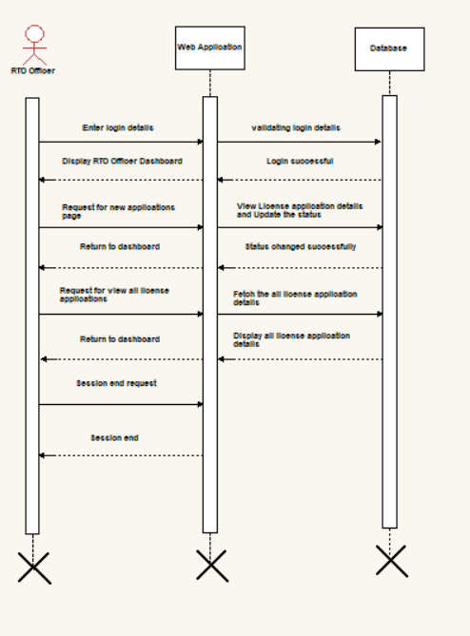
Online License module RTO Officer side

Slide 52
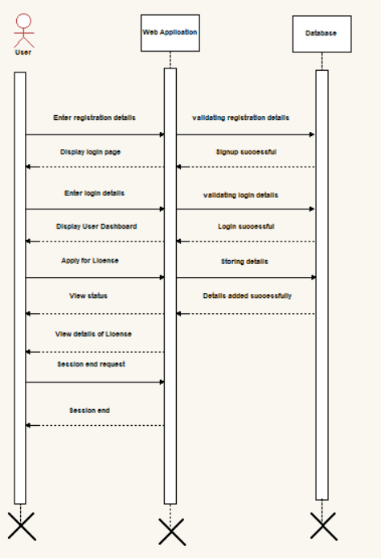
Online License module user side

Slide 53
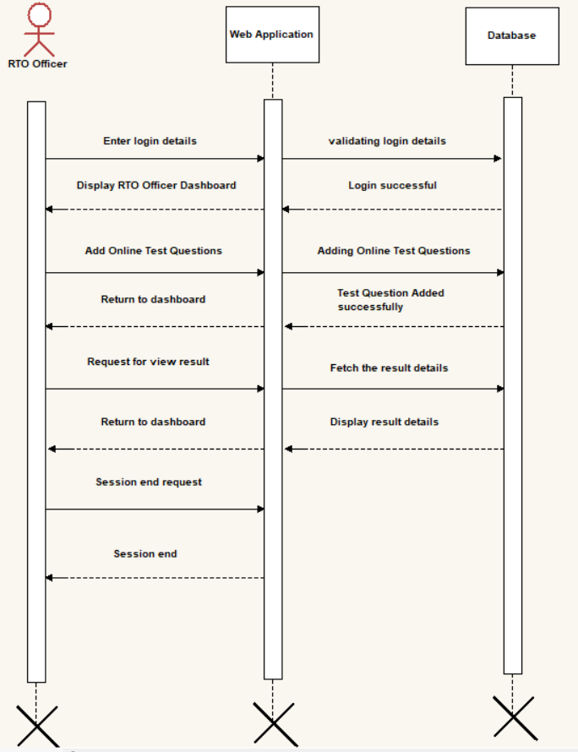
Online Test module RTO officer side

Slide 54
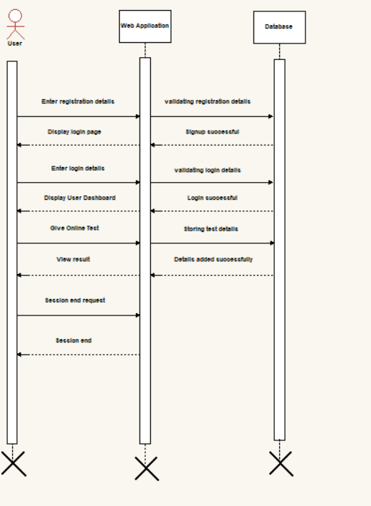
Online Test module user side

Slide 55
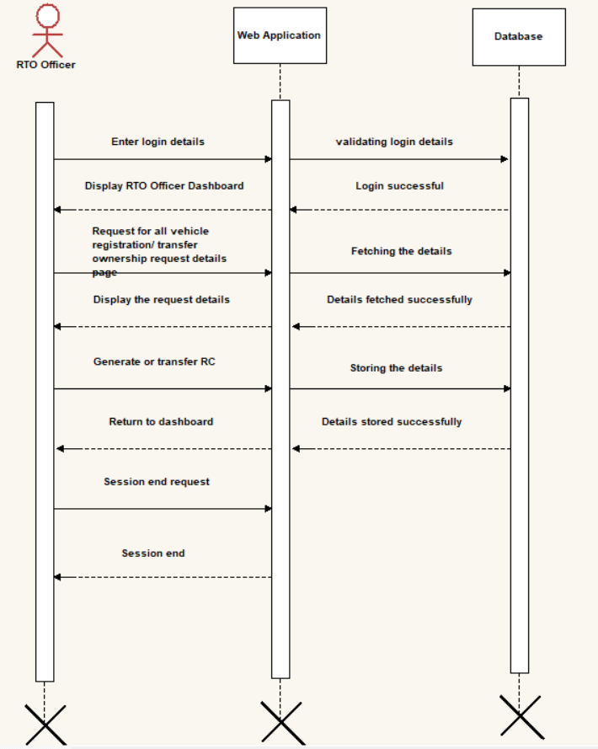
Ownership module RTO officer side

Slide 56
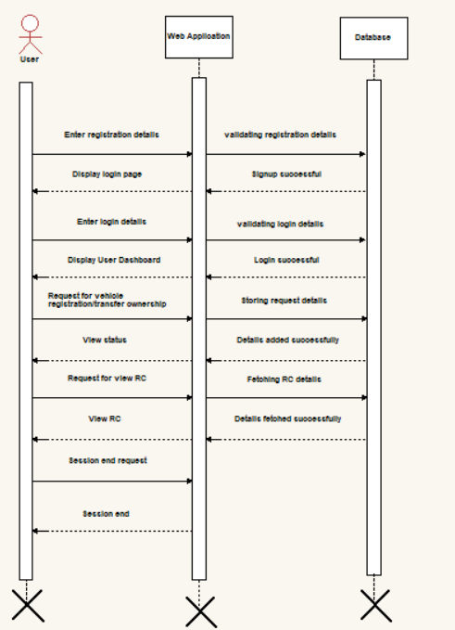
Ownership module user side

Slide 57
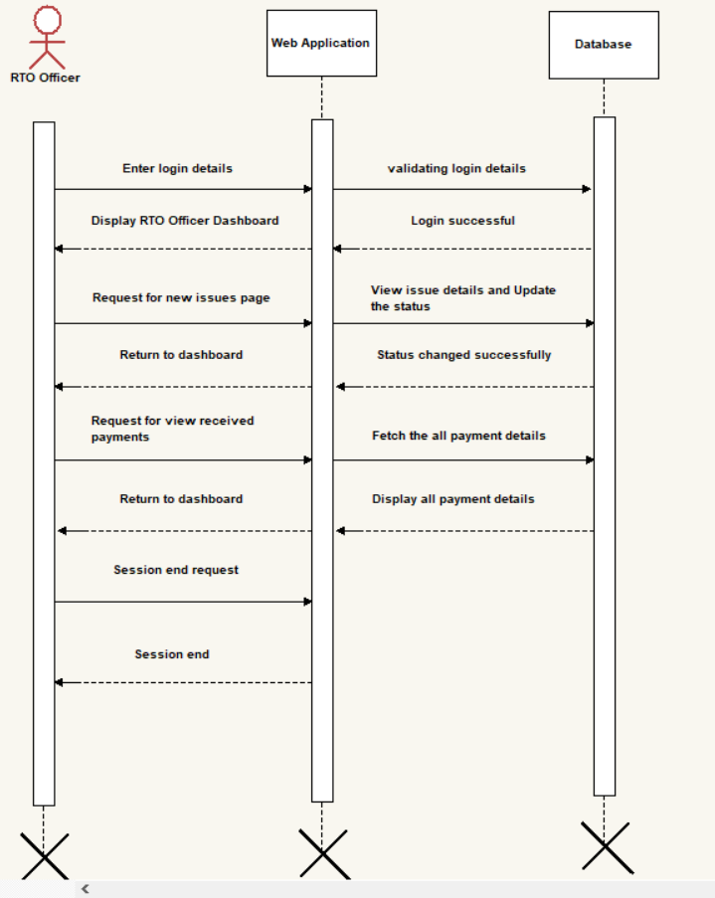
Payment module RTO officer side

Slide 58
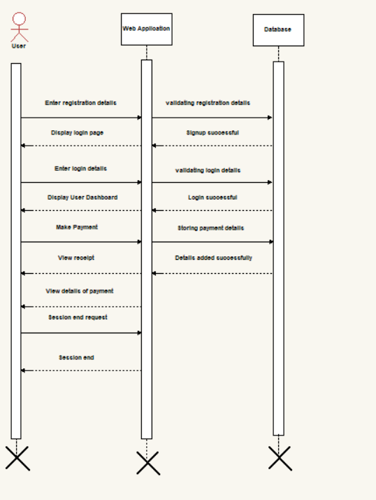
Payment module user side

Slide 59
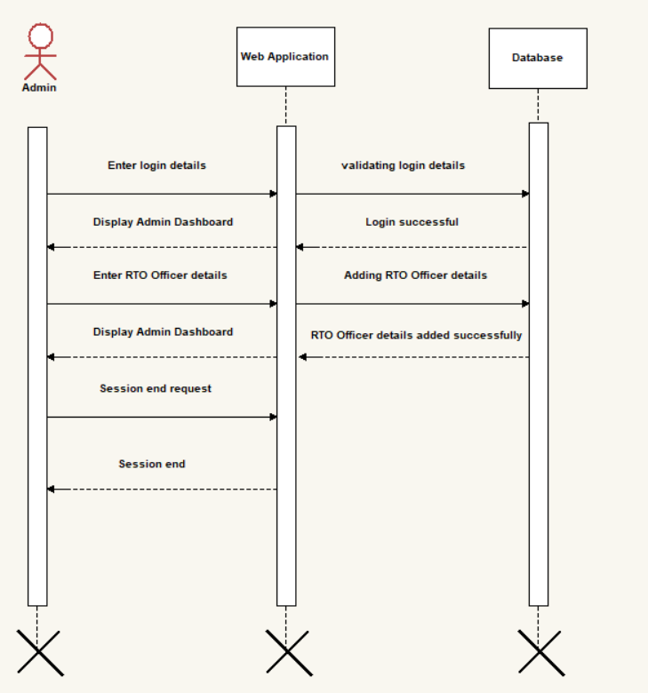
RTO Officer Management

Slide 60
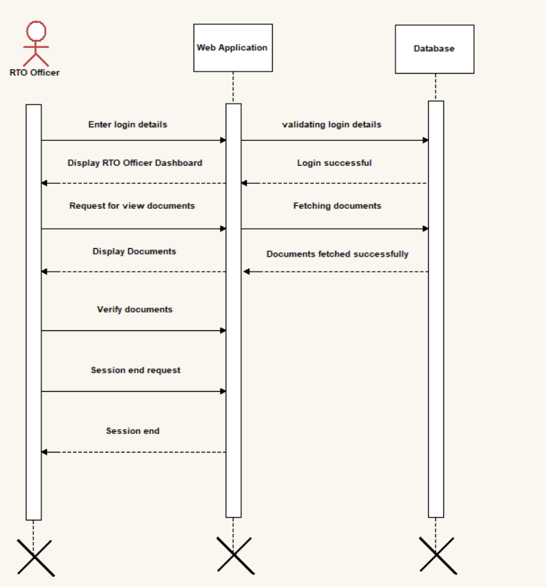
Verification Module

Slide 61
MODULE SPECIFICATION
User Management Module
Admin
User
RTO Officer
RTO Officer Management Module
Manage RTO officer details
View RTO officer details
Branch Module
Manage Branch Details
View Branch Details
Online License Module
Apply for license (Learning/Permanent)
Manage License Applications
View Application Status
View all applications

Slide 62
MODULE SPECIFICATION
Issue Module
Renewal of License/ Modification in license information/ Insurance renewal
Manage issues
View the status
Verification Module
Document
Receipt
Payment Module
Make Payment
View Received Payments
View Receipt
Test Module
Manage Test questions
Give Online test
View Result

Slide 63
MODULE SPECIFICATION
Ownership Module
Vehicle registration
Verification of documents
Generate/Transfer RC
View RC
Report Module
Registration report
LL report
Permanent license report

Slide 64
Table Structure
Table Name: Branch
Column | Data Type | Index | Description
Branchid | int(10) | Primary key | Branch ID
Branchname | varchar(25) | Not null | Branch name
branchaddress | Text | Not null | Branch address
City | varchar(15) | Not null | City
Pin | varchar(10) | Not null | PIN code
State | varchar(25) | Not null | State
Status | varchar(10) | Not null | Branch status

Slide 65
Table name: city
Column | Data Type | Index | Description
Cityid | int(10) | Primary key | City ID
City | varchar(50) | Foreign key | City
Stated | int(10) | Foreign key | State ID
Citycode | varchar(10) | Not null | City Code
Description | Text | Not null | Discription
Status | varchar(10) | Not null | Status

Slide 66
Table name: employee
Column | Data Type | Index | Description
Empid | int(10) | Primary key | Emp ID
Emptype | varchar(20) | Not null | Emp Type
Branched | int(10) | Foreign key | Branch ID
Empname | varchar(25) | Not null | Emp Name
Loginid | varchar(100) | Not null | Login ID
Password | varchar(100) | Not null | Password
Status | varchar(10) | Not null | Status

Slide 67
Table name: drivinglicense
Column | Data Type | Index | Description
Drivinglicenseid | int(10) | Primary key | Driving License ID
Dltype | varchar(25) | Not null | DL Type
Stated | int(10) | Foreign key | State ID
Cityid | int(10) | Foreign key | City ID
Vehicletypeid | int(10) | Foreign key | VehicleType ID
Photo | varchar(100) | Not null | Photo
Name | varchar(50) | Not null | Name
Swdof | varchar(50) | Not null | SWD of
Paddr | Text | Not null | PAddress
Taddr | Text | Not null | TAddress
Paddrduration | varchar(50) | Not null | PAddr Duration
Dob | Date | Not null | DOB
Qualification | varchar(50) | Not null | Qualification
Identificationmarks | varchar(50) | Not null | Identification Marks
Bloodgroup | varchar(10) | Not null | Blood Group
Previousdl | varchar(50) | Not null | Previous DL
Startdate | date | Not null | Start Date
Enddate | date | Not null | End Date
Entrydate | date | Not null | Entry Date
Dlno | varchar(25) | Not null | DL No
Note | text | Not null | Note
Status | varchar(10) | Not null | Status

Slide 68
Table name: payment
Column | Data Type | Index | Description
Paymentid | int(10) | Primary key | Payment ID
Paymenttype | varchar(25) | Not null | Payment Type
Paidfor | varchar(20) | Not null | Paid For
Paidamt | float(10,2) | Not null | Paid Amt
Paiddate | Date | Not null | Paid Date
Description | Text | Not null | Description
Status | varchar(10) | Not null | Status

Slide 69
Table name: question
Column | Data Type | Index | Description
Qid | int(10) | Primary key | QID
Question | text | Not null | Question
option1 | text | Not null | Option 1
option2 | text | Not null | Option 2
option3 | text | Not null | Option 3
option4 | text | Not null | Option 4
Answer | varchar(25) | Not null | Answer
Img | text | Not null | Img
Status | varchar(10) | Not null | Status

Slide 70
Table name: LLR
Column | Data Type | Index | Description
Llrid | int(10) | Primary key | LLR ID
Llrtype | varchar(50) | Not null | LLR Type
Stated | int(10) | Foreign key | State ID
Cityid | int(10) | Foreign key | City ID
Vehicletypeid | int(10) | Foreign key | Vehicle Type
Name | varchar(50) | Not null | Name
Swd | varchar(25) | Not null | SWD Of
Photo | varchar(100) | Not null | Photo
Paddr | text | Not null | PAddr
Taddr | text | Not null | Taddr
Paddrduration | varchar(50) | Not null | PAddr Duration
Dob | date | Not null | DOB
Birthplace | varchar(50) | Not null | Birth Place
Qualification | varchar(25) | Not null | Qualification
Identificationmarks | text | Not null | Identification Marks
Bloodgroup | varchar(25) | Not null | Blood Group
Startdate | date | Not null | Start Date
Enddate | date | Not null | End Date
Note | text | Not null | Note
Staus | varchar(10) | Not null | Status

Slide 71
Table name: state
Column | Data Type | Index | Description
Stated | int(10) | Primary key | State ID
State | varchar(50) | Not null | State
Statecode | varchar(10) | Not null | State Code
Description | text | Not null | Description
Status | varchar(10) | Not null | Status

Slide 72
Table name: test
Column | Data Type | Index | Description
Testid | int(10) | Primary key | Test ID
Userid | int(10) | Foreign key | User ID
Examfor | varchar(25) | Not null | Exam For
Qid | int(10) | Foreign key | Q ID
Answer | varchar(10) | Not null | Answer
Marks | int(10) | Not null | Marks
Status | varchar(10) | Not null | Status

Slide 73
Table name: user
Column | Data Type | Index | Description
Userid | int(10) | Primary key | User ID
Name | varchar(20) | Not null | Name
Emailed | varchar(25) | Not null | Email ID
Password | varchar(100) | Not null | Password
Contactno | varchar(15) | Not null | Contact No
Status | varchar(10) | Not null | Status

Slide 74
Table name: vehicleregistration
Column | Data Type | Index | Description
Vehicleregid | int(10) | Primary key | Vehicle Reg ID
Userid | int(10) | Foreign key | User ID
Stated | int(10) | Foreign key | State ID
Cityid | int(10) | Foreign key | City ID
Ownername | varchar(50) | Not null | Owner Name
Swdof | varchar(50) | Not null | SWD Of
Regtype | varchar(25) | Not null | Reg Type
Dob | date | Not null | DOB
Paddr | text | Not null | PAddr
Taddr | text | Not null | TAddr
Paddrduration | varchar(50) | Not null | PAddr Duration
Pancardno | varchar(25) | Not null | PanCard No
Birthplace | varchar(50) | Not null | Birth Place
Vehiclepurchasedfrom | text | Not null | Vehicle Purchased Form
Vehicletypeid | int(10) | Not null | Vehicle Type ID
Vehicledetail | text | Not null | Vehicle Detail
Chasisno | varchar(50) | Not null | Chasis No
Engineno | varchar(50) | Not null | Engine No
Seatingcapacity | varchar(50) | Not null | Seating Capacity
Fuel | varchar(50) | Not null | Fuel
Vehicleimg | varchar(100) | Not null | Vehicle Img
Note | text | Not null | Note
Date | date | Not null | Date
Vehicleno | varchar(50) | Not null | Vehicle No
Status | varchar(50) | Not null | Status

Slide 75
Table name: vehicletype
Column | Data Type | Index | Description
Vehicletypeid | int(10) | Primary key | Vehicle Type ID
Vehicletype | varchar(20) | Not null | Vehicle Type
Description | text | Not null | Description
Status | varchar(10) | Not null | Status

Slide 76
Proposed Enhancement
In future this project can be update in many ways where the user easy purpose it can be modified to the various fields in the project.
This web application helps for RTO office employees as well as citizens of India. It will reduce considerably the difficulties faced on existing system, with minimum error and difficulties.

Slide 77
Conclusion
We here by conclude this project called RTO governance System in order to issue the Driving License, Learner`s License, Vehicle Registration can be done online to avoid the purpose of cause from traffic police.
During the vehicle must have separate documents when anyone who wants to drive, they must follow the rule of Karnataka Government. This project works online which helps RTO office employees and Indian citizens. The System keeps track of the transactions in the RTO office

Slide 78
Thank You

